Slide 1


RECURSION
Recursion is a problem-solving approach that can be used to generate simple solutions to certain kinds of problems that would be difficult to solve in other ways

Slide 2
To iterate is human, to recurse divine.
− L. Peter Deutsch
“It seems very pretty … but it’s rather hard to understand!”
− Lewis Carroll (Through the Looking-Glass, Chapter 1)

Slide 3
Steps to Design a Recursive Algorithm
There must be at least one case (the base case), for a small value of n, that can be solved directly
A problem of a given size n can be split into one or more smaller versions of the same problem (recursive case)
Recognize the base case and provide a solution to it
Devise a strategy to split the problem into smaller versions of itself while making progress toward the base case
Combine the solutions of the smaller problems in such a way as to solve the larger problem
Notes:
Note: If a recursive function never reaches its base case, a stack overflow error occurs

Slide 4
Content of a Recursive Method
Base case(s).
  Values of the input variables for which we perform no recursive calls are called base cases (there should be at least one base case).
  Every possible chain of recursive calls must eventually reach a base case.
Recursive calls.
  Calls to the current method.
  Each recursive call should be defined so that it makes progress towards a base case.

Slide 5
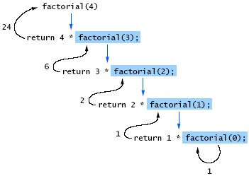
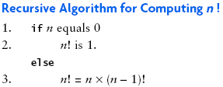
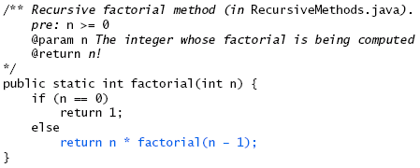
Recursive Factorial Method
Task: Design a recursive approach for calculating n!
( Note: n! = n*(n-1)*(n-2)*…*3*2*1, so 5! = 5*4*3*2*1 = 120 )
return
call
4
*
6
=
24
final answer
recursiveFactorial
(
4
)
call
return
3
*
2
=
6
recursiveFactorial
(
3
)
call
return
2
*
1
=
2
recursiveFactorial
(
2
)
call
return
1
*
1
=
1
recursiveFactorial
(
1
)
call
return
1
recursiveFactorial
(
0
)

Slide 6
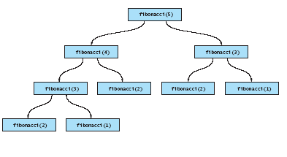
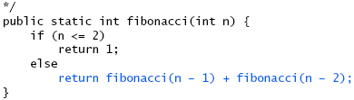
An Exponential Recursive Fibonacci Method

Slide 7
Example: The Sum of the First N
Positive Integers
Definition:
  sum(n) = n + (n-1) + (n-2) + … + 1 for any integer n > 0
Recursive relation;
  sum(n) = n + [(n-1) + (n-2) + … + 1]
  = n + sum(n-1)
  Looks so nice, but how about n == 1?
  sum(1) = 1 + sum(0), but the argument to sum( ) must be positive
Final recursive definition:
  sum(n) = 1 if n = 1 (Base case)
  = n + sum(n-1) if n > 1 (Recursive call)

Slide 8
Recursive Definition of sum(n)
int sum(int n)
{
if (n == 1) // base case
return 1;
else
return n + sum(n-1); // recursive call A
}

Slide 9
Example 4: Binary Search
Basic Recursions
An entire sorted list
First half
Second half
First half
Second half
First half
The search divides a list into two small sub-lists till a sub-list is no more divisible.
Each step needs the top/tail indexes and a target item.
Can we call binarySearch( ) recursively?

Slide 10
Binary Search (Recursive Version)
Basic Recursions
int binarySearch( const int array[], int top, int tail, int target ) {
int mid = (top + tail)/2;
if ( target == array[mid] )
return mid; // find it
else if ( top > tail )
return -1; // cannot find it
else if ( target < array[mid] )
return binarySearch( array, top, mid-1, target );
else if ( target > array[mid] )
return binarySearch( array, mid+1, tail, target );
}

Slide 11
The Tower of Hanoi

Slide 12
Tower of Hanoi
It provides analysis of recursive algorithm
If rods = 3
rings = 64 of different sizes
All rings are arranged in decreasing size on rod 1 (the largest at the bottom and the smallest at the top)
Transfer all the rings to the 2nd rod
  Move one ring in one move
  No ring is even placed on top of another smaller one on any rod
Time required to finish this work for 64 rings is 500000 million years if one ring is moved in one second

Slide 13
TOWER (N, BEG, AUX, END)
If N=1 then BEG "→" END
If N>1 then
Tower (N-1, BEG, END, AUX) Moves (N-1) from peg BEG to AUX
write BEG "→" END
Tower (N-1, AUX, BEG, END) Moves (N-1) from peg AUX to BEG
A
B
C
Initial setup of Towers of Hanoi with n = 6

Slide 14
Recursive Solution

Slide 15
Recursive Solution

Slide 16
Recursive Solution

Slide 17
Recursive Solution

Slide 18
Tower of Hanoi

Slide 19
Tower of Hanoi

Slide 20
Tower of Hanoi

Slide 21
Tower of Hanoi

Slide 22
Tower of Hanoi

Slide 23
Tower of Hanoi

Slide 24
Tower of Hanoi

Slide 25
Tower of Hanoi

Slide 26
n = 3
(a) Initial
(1) A → C
(2) A → B
(3) C → B
(4) A → C
(5) B → A
(6) B → C
(3) A → C

Slide 27
n = 3
TOWER (1, A, B, C)
A → C
TOWER (2, A, C, B)
A → B
TOWER (1, C, A, B)
C → B
TOWER (3, A, B, C)
A → C
TOWER (1, B, C, A)
B → A
TOWER (2, B, A, C)
B → C
TOWER (1, A, B, C)
A → C

Slide 28
n = 4
TOWER (1, A, C, B)
A → B
TOWER (2, A, B, C)
A → C
A → C
TOWER (1, B, A, C)
B → C
TOWER (3, A, C, B)
A → B
A → B
TOWER (1, C, B, A)
C → A
TOWER (2, C, A, B)
C → B
C → B
TOWER (1, A, C, B)
A → B
TOWER (4, A, B, C)
A → C
A → C
TOWER (1, B, A, C)
B → C
TOWER (2, B, C, A)
B → A
B → A
TOWER (1, C, B, A)
C → A
TOWER (3, B, A, C)
B → C
B → C
TOWER (1, A, C, B)
A → B
TOWER (2, A, B, C)
A → C
A → C
TOWER (1, B, A, C)
B → C

